Slide 3
Aplicaciones de SharePoint en la Nube

Slide 4


Gustavo Velez
MVP SharePoint Server
http://www.gavd.net
gustavo@gavd.net

Slide 5


Fabian Imaz
Siderys
Arquitecto
MVP SharePoint Server
http://www.siderysbsn.com
http://blog.siderys.com
@fabianimaz

Slide 6

Agenda
Introduction
Development environment
Seller Dashboard
Types Apps
SharePoint Hosted Apps
Introduction
Programming in JavaScript
App Parts
UI Custom Actions
SharePoint Provider Hosted Apps
Introduction
Programming in C#
Programming in JavaScript
Chrome Control
Remote Event Receivers

Slide 7
Introduction

Slide 8
Apps for SharePoint Dev Environment
Office 365 Developer Site Collection
Windows Azure Subscription (not obligatory, but useable for AD)
Visual Studio 2013
Visual Studio 2015
Office Developer Tools for Visual Studio 2013 (not obligatory, but useable for Office 365 development)

Slide 9
Setting up Environments
Sign up for an Office 365 subscription
Create a Developer Site Collection
Sign up for Windows Azure subscription
Link Office 365 AAD to Windows Azure (not obligatory)
Make Office 365 user administrator in Windows Azure (not obligatory)
Use Visual Studio remotely to develop

Slide 10
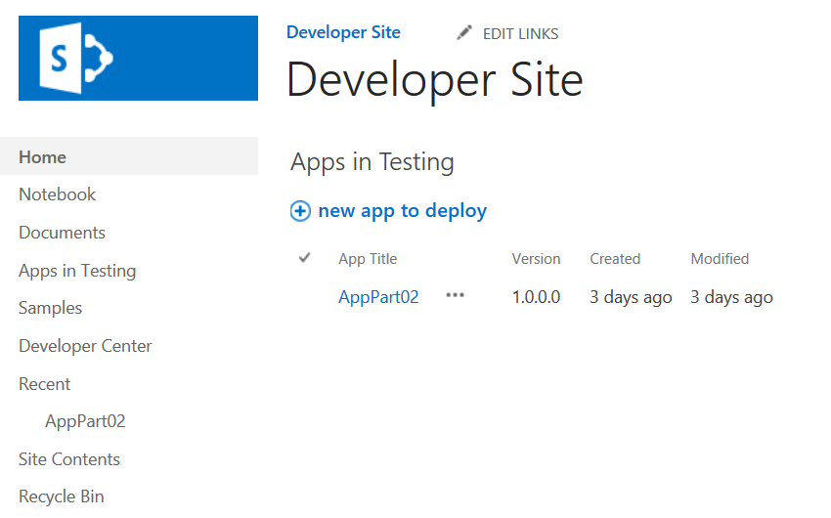
Developer Site Collection
Required for remote app development
Created automatically if you sign up for an Office 365 Developer Site
Use the Developer Site template to create a new Site Collection in an existing tenancy
Notes:
An Office 365 Developer Site makes it easier to get set up and start creating, testing, and deploying your apps for Office and SharePoint more quickly. Office 365 enterprise (E3 or E4) subscriptions include a site template you can use to create a Developer Site.

Slide 11
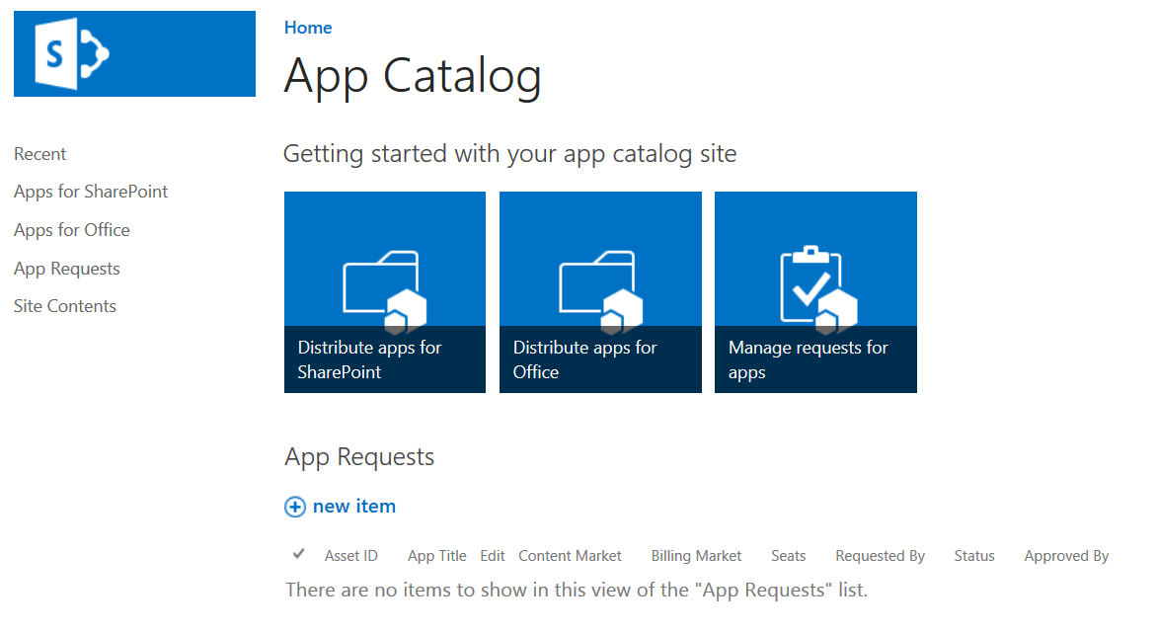
App Catalog
Required to publish apps
Create in the SharePoint Admin Center Apps/App Catalog
Notes:
As a SharePoint Online admin, you can create an App Catalog site to make internally developed custom apps available for users to install when they browse apps under the From Your Organization filter on the Site Contents page. Site owners can then add these apps to customize sites with specific functionality or to display information.
After an App Catalog site has been created, you can use it to upload any custom apps that your organization has developed. Uploading custom apps is not much more complicated than uploading a document to a library and setting some properties. You can also use the App Catalog site to do things like install custom or third-party apps on sites for users (also called app deployment). You can also manage app requests from users.

Slide 12
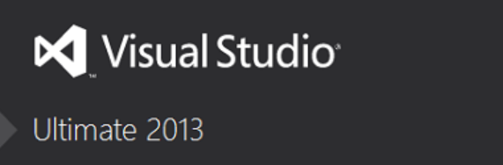
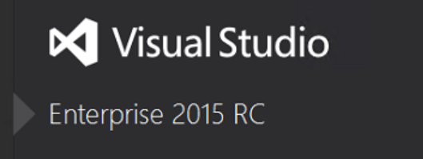
Visual Studio 2013 / 2015
90-Day Trial VS 2013
http://www.visualstudio.com/en-us/downloads/download-visual-studio-vs.aspx
RC VS 2015
https://www.visualstudio.com/en-us/downloads/visual-studio-2015-downloads-vs.aspx

Slide 13
Link Office 365 and Azure
(Not Obligatory)
Log into Microsoft Azure subscription as administrator
Click on the Active Directory link.
Click New>Active Directory>Directory>Custom Create
Select to Add an Existing Directory
Follow the steps to add an existing directory
Notes:
It’s not required to link the Office 365 Directory to an Azure subscription
for simply creating provider-hosted apps, but it makes life a bit easier
and opens up the ability to call into Office 365 from other applications.

Slide 14
Office 365 Account as Azure Admin
Log into an existing Microsoft Azure as administrator
Click the Settings link
Click Administrators
Click Add
Add the Organizational Account from Office 365
Notes:
By adding an Office 365 account as an Azure administrator,
you can use a single account for managing both subscriptions

Slide 15
Seller Dashboard Overview
Required to submit apps to Microsoft marketplaces
Apps for SharePoint
Apps for Office
Windows 8.1
Azure Marketplace
May be company or individual
Notes:
If you are a software developer who creates apps that support or enhance Microsoft technologies, such as Microsoft SharePoint, Microsoft Office, and Azure, you can use the Seller Dashboard to submit and distribute your apps to Microsoft marketplaces.

Slide 16
Seller Dashboard Sign Up Process
Obtain a Microsoft account, if you do not have one
Sign into the Seller Dashboard with your Microsoft Account
http://go.microsoft.com/fwlink/?LinkId=248605
Fill in the registration information
Submit for approval

Slide 17
Seller Dashboard Publishing Process
Build the app
Upload app to your Seller Dashboard account
Submit app for approval
See app in the marketplace
Track app usage and receive payout

Slide 18
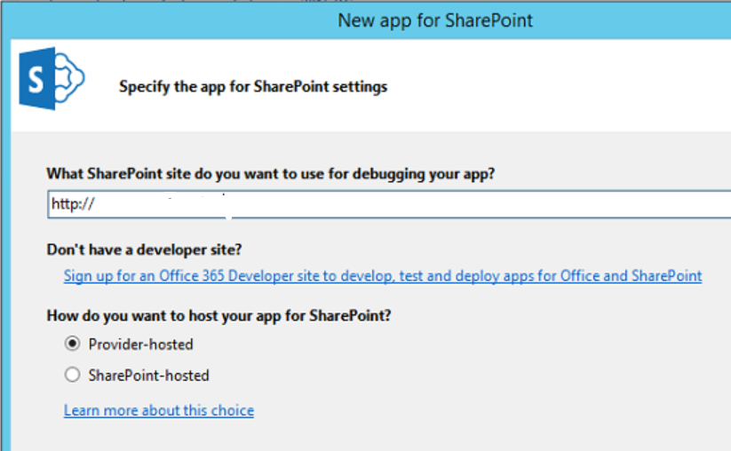
App for SharePoint – Provider types

Slide 19
App for SharePoint – Interface types
Full Page
Implement complete app experiences to satisfy business scenarios
Parts
Create app parts that can interact with the SharePoint experience
UI Command Extensions
Add new commands to the ribbon and item menus

Slide 20
Deep Dive into SharePoint Hosted Apps

Slide 21
Architecture (SharePoint-Hosted Apps [OnPrem+365])
SharePoint (OnPrem/365)
Host Web
SubSPWeb + AppWeb
-SubWeb under HostWeb
-Separate Domain
-Created during App Installation
ACS
ACS (Access Control Service):
- OnPrem: SharePoint
- 365: AACS
Notes:
App Web is a sub web under the host web
App web is a separate domain
App web is created during app installation process
App web contains pages and other declarative SharePoint artifacts
App web is limited to JavaScript
App web can access host web as long as it has appropriate permissions
May call to other cross-domain resources using appropriate techniques such as cross-origin resource sharing (CORS) or a web proxy

Slide 22
The App Web
App Web is isolated in its own domain
Enforces “Same Origin” policy for the app
Allows for authentication and authorization when calls are made to the host web
Each app has it’s own unique URL
Tenancy – your organization’s tenancy
App Unique Identifier – unique generated identifier for the app instance
Hosting Domain – defined for each farm
App Name – contained in the app manifest
https://[tenancy]-[appuid].[hostingdomain]/[appname]
Notes:
Each app web is isolated in a unique domain

Slide 23
App Start Page
Specified in App Manifest
~appWebUrl/Pages/Default.aspx?{StandardTokens}
Utilizes Tokens for dynamic replacement of parameters
~appWebUrl token representing the URL for the app web of this app instance
{StandardTokens} passes key query string parameters to the app on launch
Parameter | Description
SPHostUrl | The URL of the host web
SPAppWebUrl | The URL of the app web
SPLanguage | The language/culture of the host web
SPClientTag | The client cache control number for the current website
SPProductNumber | The full build version number of the SharePoint farm
Notes:
{StandardTokens} combines five other tokens. It initially resolves to SPHostUrl={HostUrl}&SPAppWebUrl={AppWebUrl}&SPLanguage={Language}&SPClientTag={ClientTag}&SPProductNumber={ProductNumber}. Then each of these tokens resolves. If there is no app web, the portion &SPAppWebUrl={AppWebUrl} is not present.

Slide 24
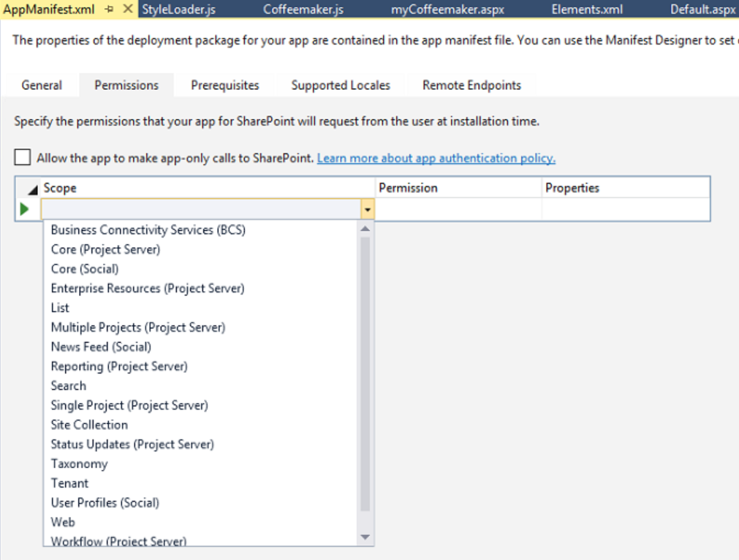
App Permissions
Utilizes “Internal” (SharePoint) Authentication
App permissions are the lesser of user and app permissions to the given resource
Notes:
No Oauth tokens required

Slide 25
App Shapes
Full Page
Required for all apps
Experienced when an app is launched from the contents page
App Part
Optional
Allows an app to be hosted in an IFrame on the host web
UI Custom Action
Optional
Allows an app to be launched from the ribbon or Edit Control Block(ECB)
Notes:
These are the different experiences
We’ll cover these in detail as we go along

Slide 26
Creating SharePoint-Hosted Apps
Pages
ASPX
HTML
Authorization
Internal SharePoint
Programmability
JavaScript (REST or CSOM)
JavaScript Cross-Domain Library
Web Proxy
Notes:
SharePoint-Hosted apps can be built on ASPX or HTML pages
The authorization is always done with “Internal” auth, meaning no OAuth tokens
Programmability is always JavaScript
You can use CSOM, REST, cross-domain library, or web proxy in your solution

Slide 27
demo
Creating a SharePoint-Hosted App

Slide 28
Programming in JavaScript

Slide 29
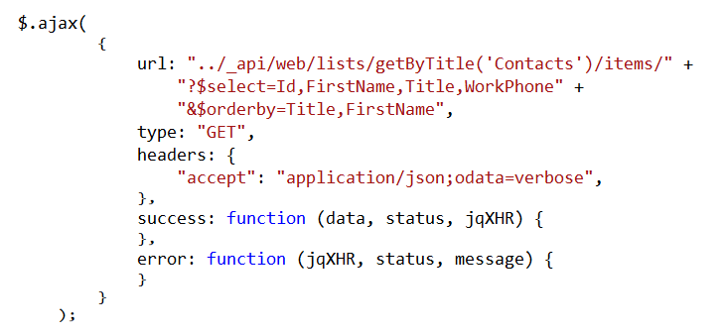
Using the REST API
Notes:
This is a READ sample. The other CRUD operations follow.

Slide 30
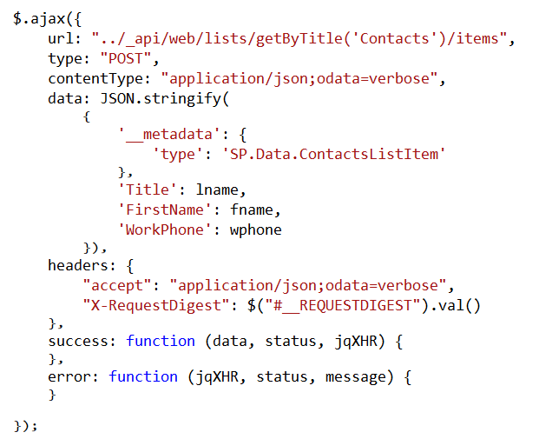
Create List Items

Slide 31
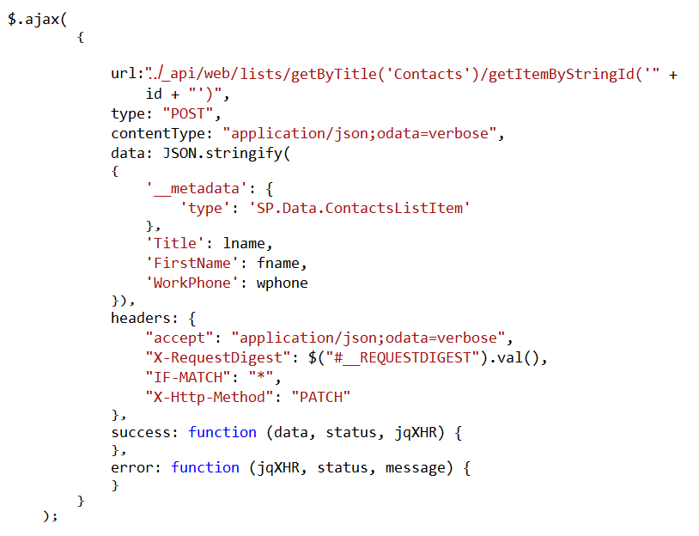
Update List Items

Slide 32
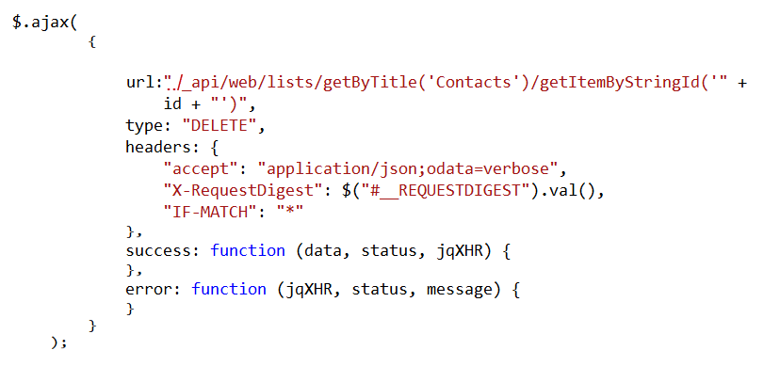
Delete List Items

Slide 33
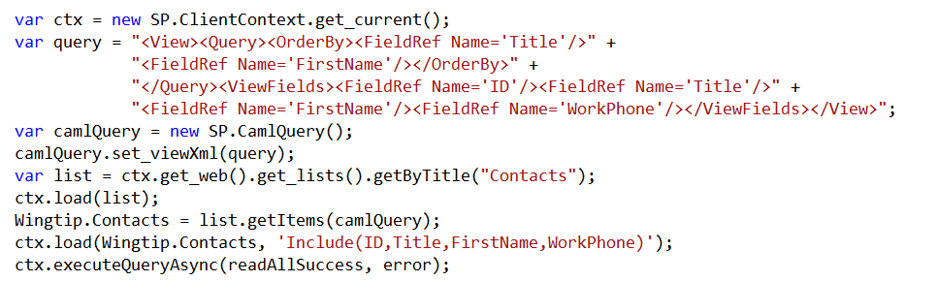
Using the CSOM API
Notes:
This is a READ sample. The other CRUD operations follow.

Slide 34
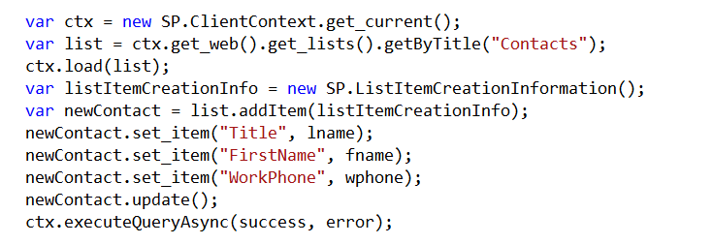
Create List Items

Slide 35
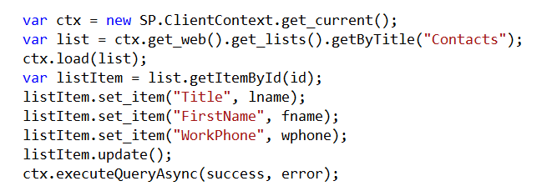
Update List Items

Slide 36
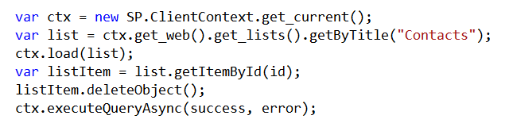
Delete List Items

Slide 37
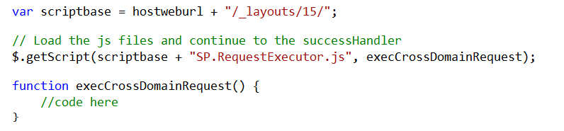
Cross Domain Library
Same-domain policy prevents JavaScript from making direct calls to the host web
SP.RequestExecutor.js located in LAYOUTS directory
Option 1: Reference directly
Option 2: Load dynamically
Notes:
Makes it possible to call the host web from JavaScript in the app web

Slide 38
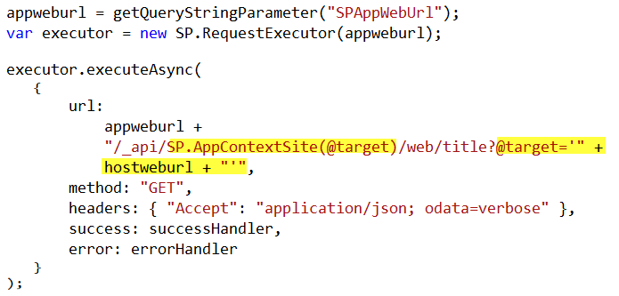
Cross-Domain REST Calls
Notes:
When calling the host web, you must switch the context

Slide 39
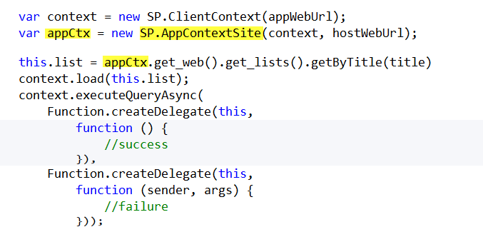
Cross-Domain CSOM Calls
Notes:
When calling the host web, you must switch the context

Slide 40
App Parts

Slide 41
App Parts
Allow functionality to be added to pages in the host web in a manner similar to web parts
App part is rendered through an IFrame on the host web
App part is defined using the Client Web Part
Supported in both SharePoint-hosted and Provider-hosted apps
Has a Configuration Panel similar to WebParts
Can use Configuration Properties similar to WebParts

Slide 42
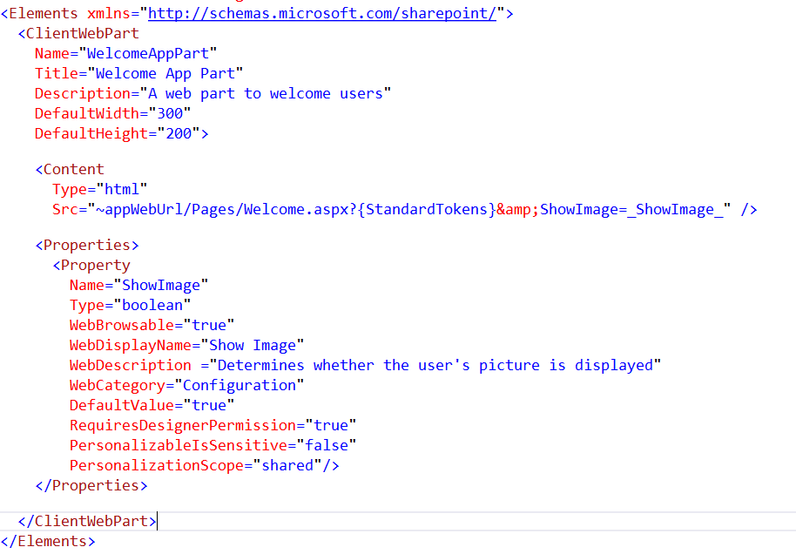
Client Web Part CAML

Slide 43
demo
Creating a SharePoint App-Part

Slide 44
UI Custom Actions

Slide 45
UI Custom Actions
Can extend the Ribbon or Edit Control Block (ECB)
Launches a target page in your app
Supports the addition of tokens to pass information to the app

Slide 46
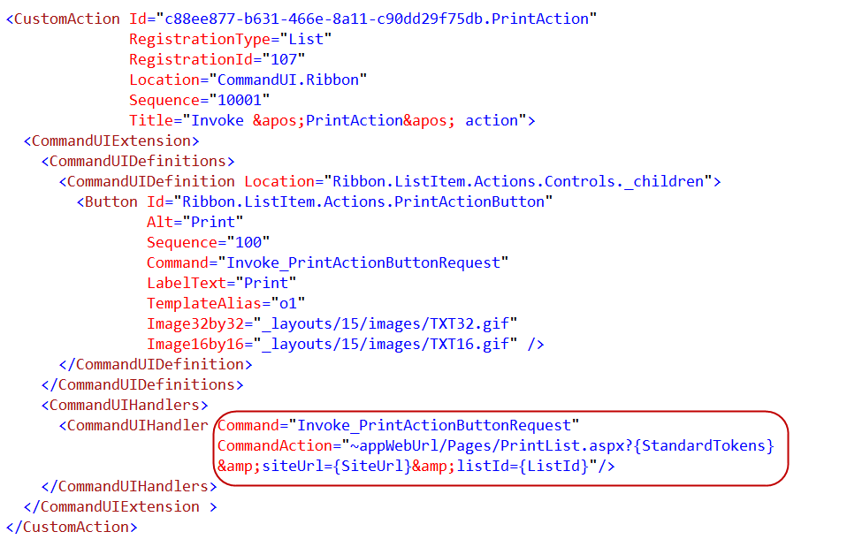
Custom Action CAML

Slide 47
Deep Dive into Provider Hosted Apps

Slide 48
Architecture (Provider-Hosted Apps [OnPrem+365])
SharePoint (OnPrem/365)
Host Web
SubSPWeb
-SubWeb under HostWeb
-Separate Domain
-Created during App Installation
ACS
Provider
ACS (Access Control Service):
- S2S
- AACS
AppWeb
Notes:
App Web is a sub web under the host web
App web is a separate domain
App web is created during app installation process
App web contains pages and other declarative SharePoint artifacts
App web is limited to JavaScript
App web can access host web as long as it has appropriate permissions
May call to other cross-domain resources using appropriate techniques such as cross-origin resource sharing (CORS) or a web proxy

Slide 49
App Permissions
Remote web always has full rights to app web
App permissions are the lesser of user and app permissions to the given resource
Provider-hosted app can utilize “app-only” permissions to “elevate” privileges.

Slide 50
App-Only Permissions
Considers app permissions only, ignores user
Set AllowAppOnlyPolicy to true in AppManifest
Get an app-only token
Notes:
Provider-hosted apps can use “app only” permissions
Update the App manifest to indicate this is OK
Then you need an app-only token in code

Slide 51
Creating Provider-Hosted Apps
Web Project
ASP.NET Web Forms
MVC 5
(Any technology)
Authorization
Azure Access Control Services
Server-to-Server High Trust
Programmability
SharePointContextProvider class
Managed CSOM or REST
JavaScript Cross-Domain Library
Notes:
Visual Studio supports both ASP.NET Web Forms and MVC5
On-premises authorization uses S2S
Cloud authorization uses OAuth
The SharePointContextProvider simplifies token management
Managed CSOm and RESt can be used directly from the server side
The cross-domain library can be used from JavaScript

Slide 52
demo
Creating a Provider-Hosted App

Slide 53
Programming in C#

Slide 54
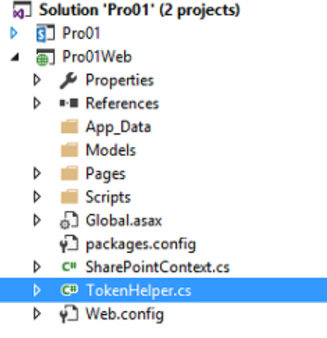
SharePointContextProvider Class
Checks for valid Context Token
Redirects if it does not exist
Simplifies the management of context
Provides an ACS or STS context
Context exposes properties for key values like Host Web URL
Simplifies the management of tokens
Context exposes methods to retrieve tokens
Notes:
The SharePointContextProvider simplifies the management of context, and tokens
It uses a cookie to store the CacheKey, and stores the actual token in session state on the server referenced by the cache key
All of this improves performance and makes programming easier

Slide 55
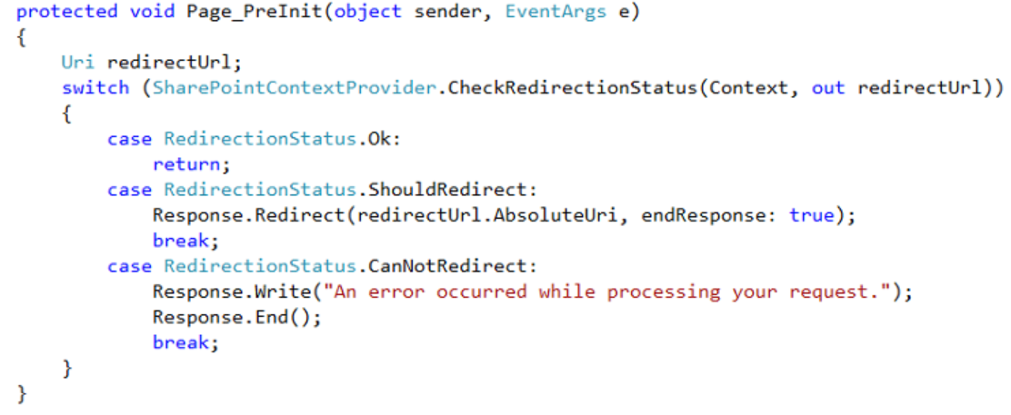
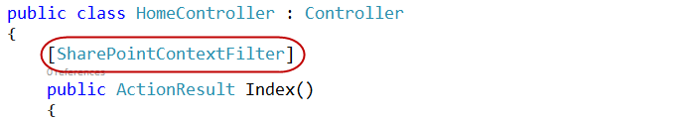
Validating Context Token
Web Forms
MVC 5
Notes:
ASP.NET Web Forms uses the PreInit method to validate the Context Token
Notice how it will redirect if the token is not valid
ASP.NET MVC 5 uses a filter to run essentially the same code
Notice how the filter attribute is applied to the controller

Slide 56
Managing SharePoint Context
SharePointContextProvider GetSharePointContext
Returns SharePointAcsContext in cloud
Returns SharePointHighTrustContext on premises
Properties
SPAppWebUrl
SPClientTag
SPHostUrl
SPLanguage
SPProductNumber
Notes:
SharePointAcsContext and SharePointHightTrustContext both inherit from SharePointContext
This means that the same code works in both cloud and on-premises environments

Slide 57
Managing Security Tokens
CSOM
CreateAppOnlyClientContextForSPAppWeb
CreateAppOnlyClientContextForSPHost
CreateUserClientContextForSPAppWeb
CreateUserClientContextForSPHost
REST
AppOnlyAccessTokenForSPAppWeb
AppOnlyAccessTokenForSPHost
UserAccessTokenForSPAppWeb
UserAccessTokenForSPHost
Notes:
The SharePointContext makes it easy to get the tokens you need

Slide 58
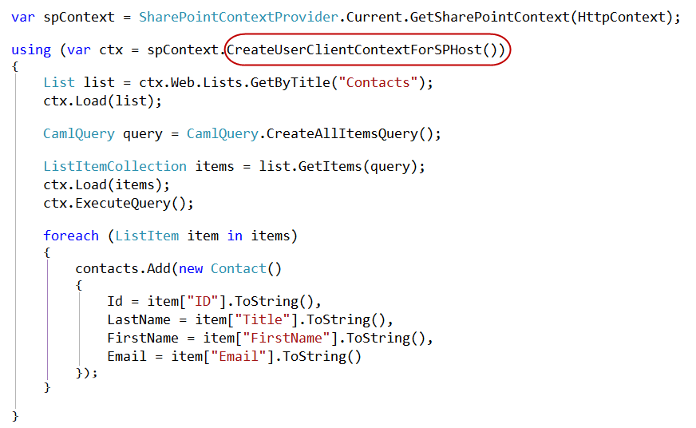
Managed CSOM

Slide 59
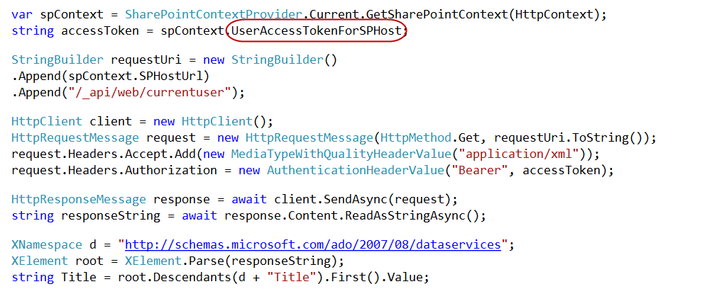
Managed REST

Slide 60
The Chrome Control

Slide 61
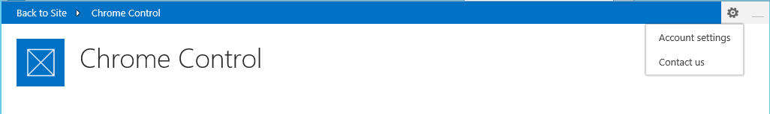
Chrome Control
JavaScript Component for creating basic banner and navigation elements
Notes:
When you create a remote web, it’s nice to have it borrow some of the characteristics of the host web
This way, it doesn’t surprise the user by changing the UI drastically

Slide 62
Loading the Chrome Control
SP.UI.Controls.js located in LAYOUTS directory
Option 1: Copy and include directly in your app
Option 2: Load Dynamically using jQuery

Slide 63
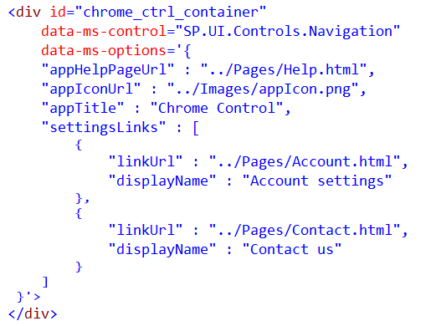
Chrome Control (Declaratively)
Notes:
Create a div tag
Use the attributes data-ms-control and data-ms-options
The chrome control will look for these attributes and render itself in this div

Slide 64
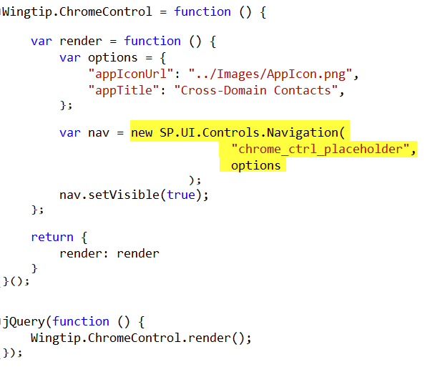
Chrome Control (Programmatically)
Notes:
Here a new chrome control is created in code
When created, it expects you to supply the options and the ID of the div where it should render
Then it renders itself in the div

Slide 65
Remote Event Receivers

Slide 66
Remote Event Handlers
Event Handler code runs in remote (SharePoint) web
Deployed as web service in remote (SharePoint) web
Two-way events
“Before” events (a.k.a, “ING” events)
Synchronous call
Supports a return value
One-way events
“After” events (a.k.a, “ED” events)
Asynchronous call
No return value
Notes:
The event handler infrastructure follows the same pattern as the in-process handlers of old
We have both “before” and “after” event
These are also known as “ING” and “ED” events like “ItemAdding” and “ItemAdded”
Two-way events are synchronous

Slide 67
Supported Events
 | Site | List | List Schema | List Item | App
Create | X | X | X | X
Update |  |  | X | X
Delete | X | X | X | X
Move | X |  |  | X
Check-In |  |  |  | X
Uncheck-In |  |  |  | X
Check-out |  |  |  | X
Attachments |  |  |  | X
File Move/Convert |  |  |  | X
Install |  |  |  |  | X
Uninstall |  |  |  |  | X
Update |  |  |  |  | X

Slide 68
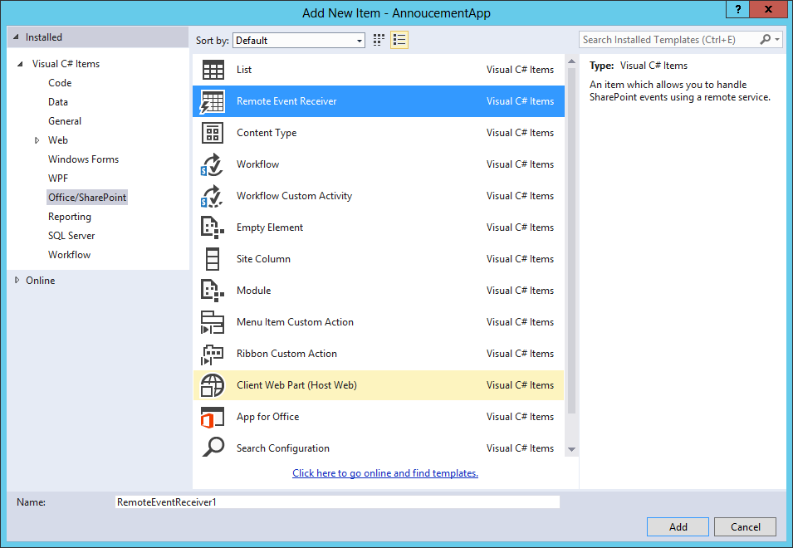
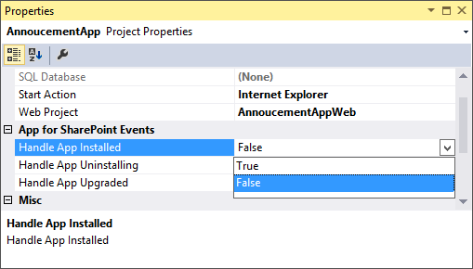
Adding a Remote Event Receiver
Use the “Add New” dialog
For Site, List, Item, and
Schema events
Use the “Properties” dialog
for App events

Slide 69
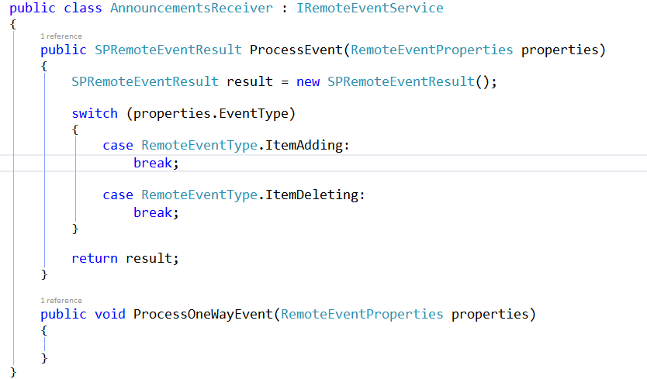
IRemoteEventService
Must be implemented by the remote (SharePoint) web service

Slide 70
SPRemoteEventProperties
Passed to web service in response to event
Provides contextual information
Supports reading and updating user inputs
Allows for data validation

Slide 71
SPRemoteEventResult
Returns by two-way events
Allows events to be cancelled
Allows status to be returned

Slide 72
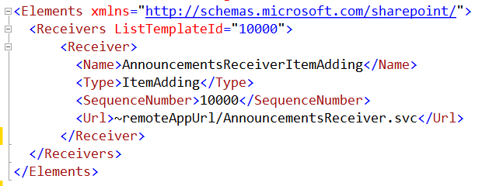
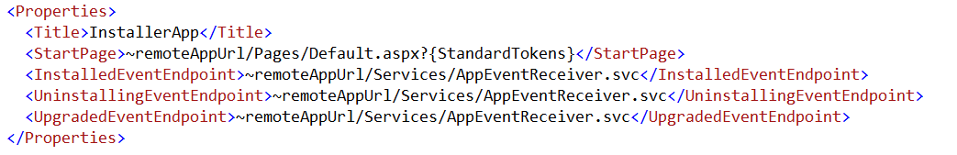
Registering Events Receivers
CAML Element for Lists, Items, Sites, Schema events
App Manifest for
App events

Slide 73
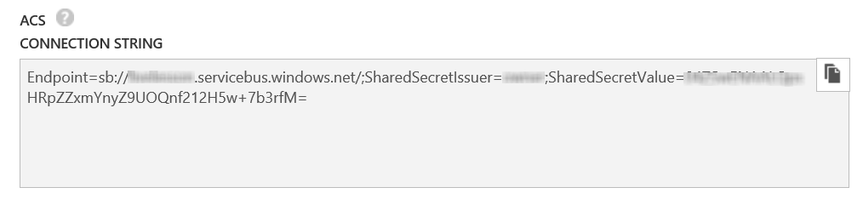
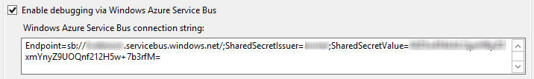
Debugging Considerations
Remote Event Receivers might require Azure Service Bus to support debugging
Create a Service Bus Namespace
Copy the Connection String into the SharePoint Project Properties
Notes:
Note that as of this writing, the Visual tooling only supports ACS strings
The Azure interface only creates SAS strings
So, you have to use PowerShell
Download and Install Azure PowerShell environment
Open PS window
Add-AzureAccount to sign in
New-AzureSBNamespace –Name “myns” -Location “Central US”
Results in an ACS string copy this to Visual Studio

Slide 74
Q&A

Slide 75
Gustavo Velez
MVP SharePoint Server
http://www.gavd.net
gustavo@gavd.net

Slide 76
Fabian Imaz
Siderys
Arquitecto
MVP SharePoint Server
http://www.siderysbsn.com
http://blog.siderys.com
@fabianimaz

